Slide 1
.Net Snake
Coding Semester 1 Final Project
by Tyler Natale

Slide 2
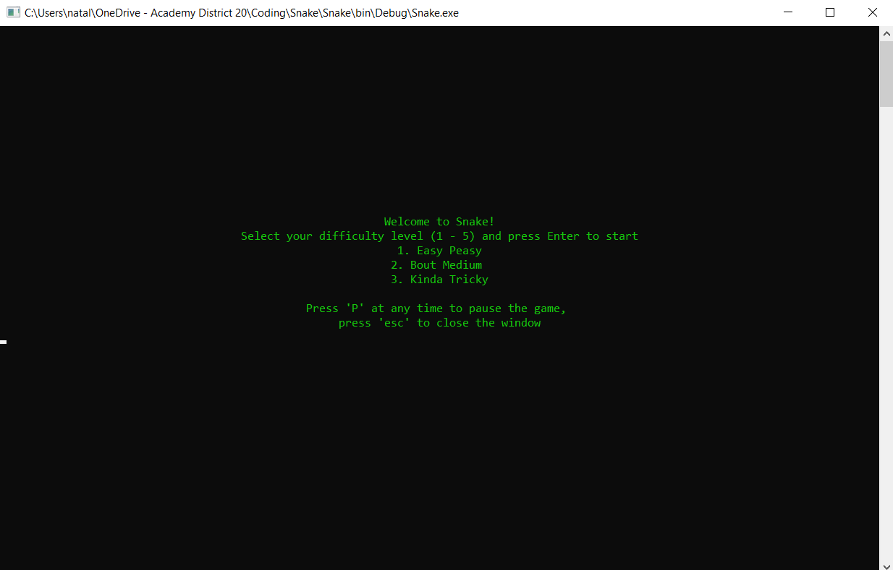
Modern version of the classic Snake game
Created using nothing but
basic C# .NET framework

Slide 3
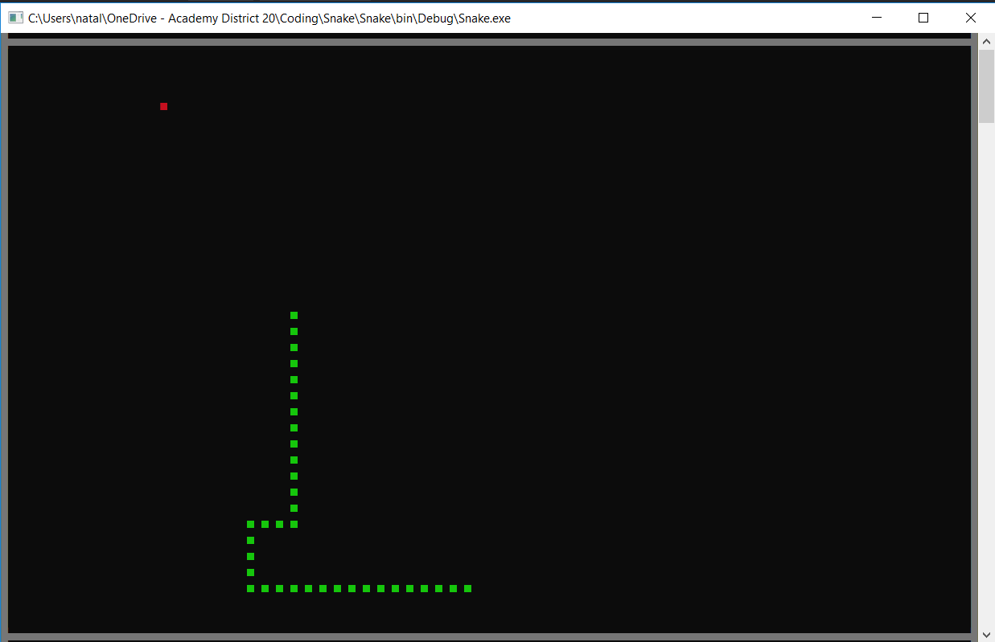
Classic look
Replicates the look of the
original game while adding
features such as selectable
difficulty levels and a local
high score board (wip)

Slide 4
Future development
Upcoming features
System for saving and displaying high scores
Bug fix - stop the berries from spawning inside you
Fix sound issues

Slide 5
Demonstration

